Slide 1
Tracking Paper Progress
Notes:
Two different parts
Use different perturbation models to perturb TFs and see what effect it has
Compare to ground truth in perturb seq
What can we learn about T-Cell Quiescence

Slide 2
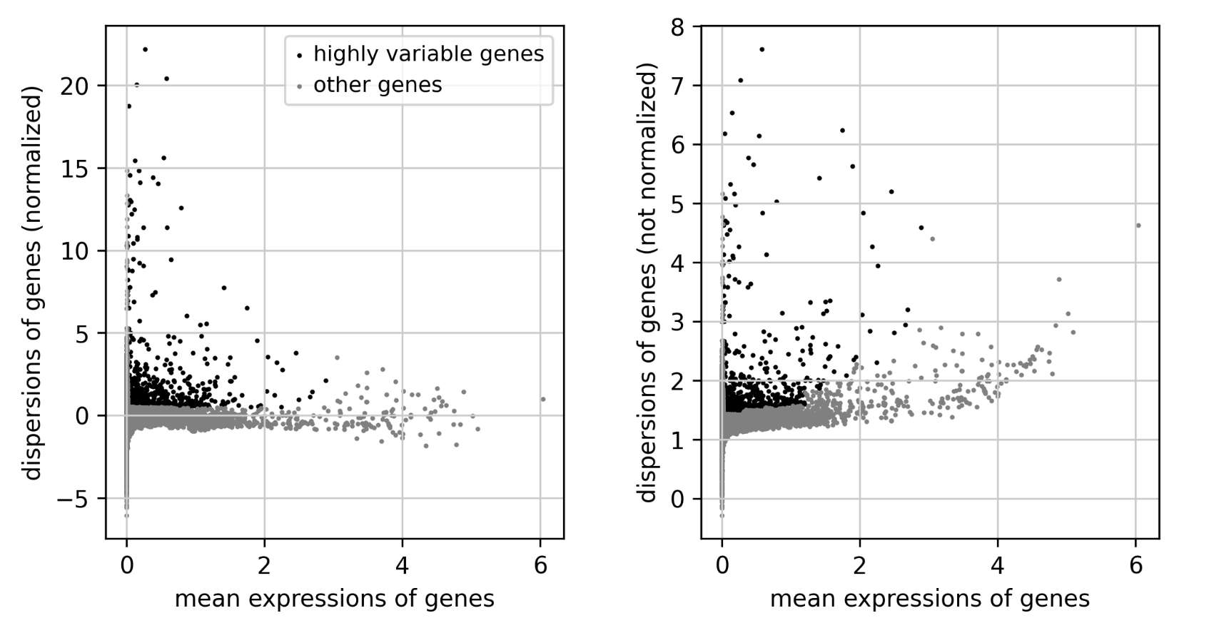

Slide 3
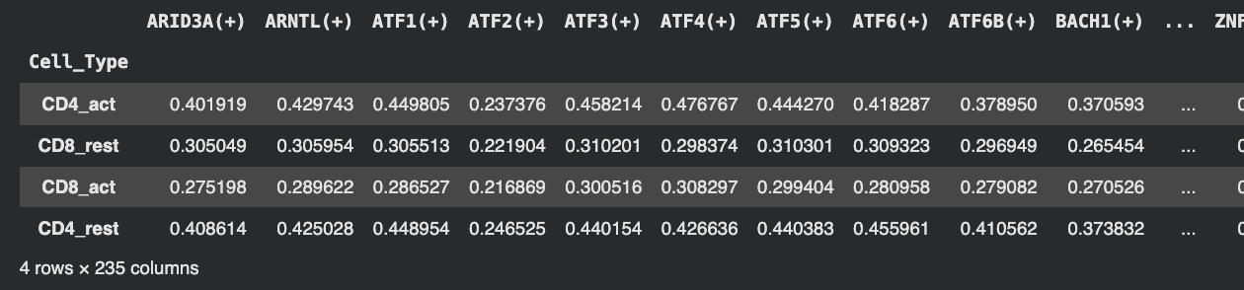
pySCENIC [With Pruning]
Key file: pruned_rss_score_matrix_final.csv
RSS = Regulon Specificity Score
"How specific is this TF's regulatory program to this cell group?"

Slide 4
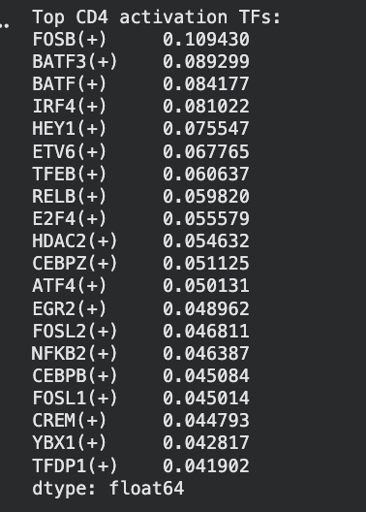
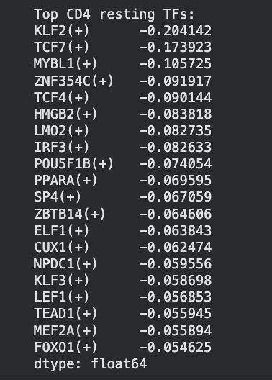
pySCENIC [With Pruning]
CD_4 Activation/Resting TFs
Calculated by CD4_Act - CD4_Rest
Notes:
https://colab.research.google.com/drive/1qZJKTo1LV7LK4-p_1tQiFkZUvUhvoWn4#scrollTo=xfFkkHMxRmEq

Slide 5
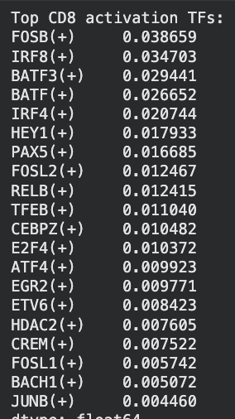
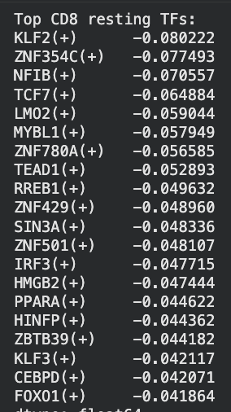
pySCENIC [With Pruning]
CD_8 Activation/Resting TFs
Calculated by CD8_Act - CD8_Rest
Notes:
https://colab.research.google.com/drive/1qZJKTo1LV7LK4-p_1tQiFkZUvUhvoWn4#scrollTo=xfFkkHMxRmEq
## scenic you get regulons → target genes from ATF4
## take those target genes and compare to ground truth data
Cd8 weaker than cd4
## way to compare?

Slide 6
Perturb-seq: Ground Truth?
Dataset Overview:
Perturb-seq Data: 33,983 rows x 10,282 genes
Our data: 47,726 cells × 58,828 genes
Notes:
https://colab.research.google.com/drive/1qZJKTo1LV7LK4-p_1tQiFkZUvUhvoWn4#scrollTo=xfFkkHMxRmEq

Slide 7
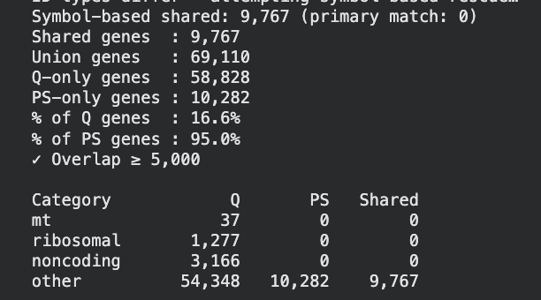
Perturb-seq: Ground Truth?
What genes match?:
95% of PS genes are in Q
16.6% of Q genes are in PS
Q = our dataset genes
PS = perturb-seq genes
Notes:
https://colab.research.google.com/drive/1qZJKTo1LV7LK4-p_1tQiFkZUvUhvoWn4#scrollTo=xfFkkHMxRmEq
CHECK IF MULTIPLE TFs OR ONE TF
QUESTION: Do we use GEARS and train on Perturb-SEQ data, or just use GEARS as it is (trained on normal-etl data, but its not cd4 data)
## summary table of how many (+), (-)

Slide 8
Perturb-seq: Ground Truth?
What genes match?:
95% of PS genes are in Q
16.6% of Q genes are in PS
Notes:
https://colab.research.google.com/drive/1qZJKTo1LV7LK4-p_1tQiFkZUvUhvoWn4#scrollTo=xfFkkHMxRmEq

Slide 9
Perturb-seq: Ground Truth?
What columns in psdata.obs contains the perturbed gene name (TF)?
17,818 perturbation entries target genes that ACTUALLY exist in our quiescence dataset
6,832 distinct perturbed genes were significant, not off-target, and exist in our dataset
IMPORTANT: not all 6,832 genes are “TFs”
With this we can:
Pick top TFs per condition
Compare model predictions under simulated perturbation
Benchmark:
Linear models
Foundation models
Notes:
https://colab.research.google.com/drive/1qZJKTo1LV7LK4-p_1tQiFkZUvUhvoWn4#scrollTo=xfFkkHMxRmEq

Slide 10
Perturb-seq: Ground Truth?
What columns in psdata.obs contains the perturbed gene name (TF)?
17,818 perturbation entries target genes that ACTUALLY exist in our quiescence dataset
6,832 distinct perturbed genes were significant, not off-target, and exist in our dataset
IMPORTANT: not all 6,832 genes are “TFs”
With this we can:
Pick top TFs per condition
Compare model predictions under simulated perturbation
Benchmark:
Linear models
Foundation models
Notes:
https://colab.research.google.com/drive/1qZJKTo1LV7LK4-p_1tQiFkZUvUhvoWn4#scrollTo=xfFkkHMxRmEq

Slide 11
Feb 25
Ask scprint if they can do perturbation
Test the scprint code + contact him
Test gears vs perturb seq x
Make graph here of TFs we have x
Think of methodology to perturb + test

Slide 12
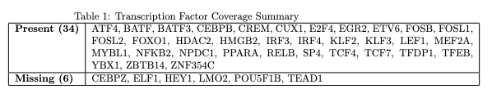
Intersection of TF’s in Perturb-Seq and Our Data

Slide 13
GEARS versus Perturb-Seq
GEARS is a deep learning model that predicts post-perturbation.
It takes unperturbed gene expression + a perturbation set as input and outputs predicted post
Marson 2025 genome-scale Perturb-seq dataset (CZI)
Pure wet lab experimental data
Primary human CD4+ T cells drawn from 4 real blood donors

Slide 14
March 4th
Run GRN w/pySCENIC x
Try fine-tuning the sprint model using our dataset
How many TF in perturb-seq dataset x
Check how many of 1635 TFs in perturb seq (add yes/no column)
Understand outline
Consider data leakage

Slide 15
scPRINT Cell Embeddings - not useful
Generated columns:
scprint_emb_cell_type_ontology_term_id
scprint_emb_tissue_ontology_term_id
scprint_emb_disease_ontology_term_id
scprint_emb_age_group
scprint_emb_assay_ontology_term_id
scprint_emb_self_reported_ethnicity_ontology_term_id
scprint_emb_sex_ontology_term_id
scprint_emb_organism_ontology_term_id
scprint_emb_cell_culture

Slide 16
scPRINT GRN w most var across
Most var across = selects the 2000 genes that distinguish each condition from the other
For rest = picks genes that are uniquely variable in rest cells compared to act
For act = picks genes that are uniquely variable in act cells compared to rest

Slide 17
scPRINT GRN w most var across
Generated files:
Two GRN h5ad files produced by scPRINT 2
2000 x 2000 attention weight matrix where
Entry [i, j] = how strongly gene i regulates gene j in that cell state
Out of rest, 2000 genes: 211 identified as TFs
Out of act, 2000 genes, 110 identified TFs
These numbers are different because it picks the 2000 genes that are most variable in that cell type

Slide 18
scPRINT GRN w most var across
Generated files:
Two GRN h5ad files produced by scPRINT 2
2000 x 2000 attention weight matrix where
Entry [i, j] = how strongly gene i regulates gene j in that cell state
Out of rest, 2000 genes: 211 identified as TFs
Out of act, 2000 genes, 110 identified TFs
THERE ARE NO SHARED GENES IN THESE 2000 GENES

Slide 19
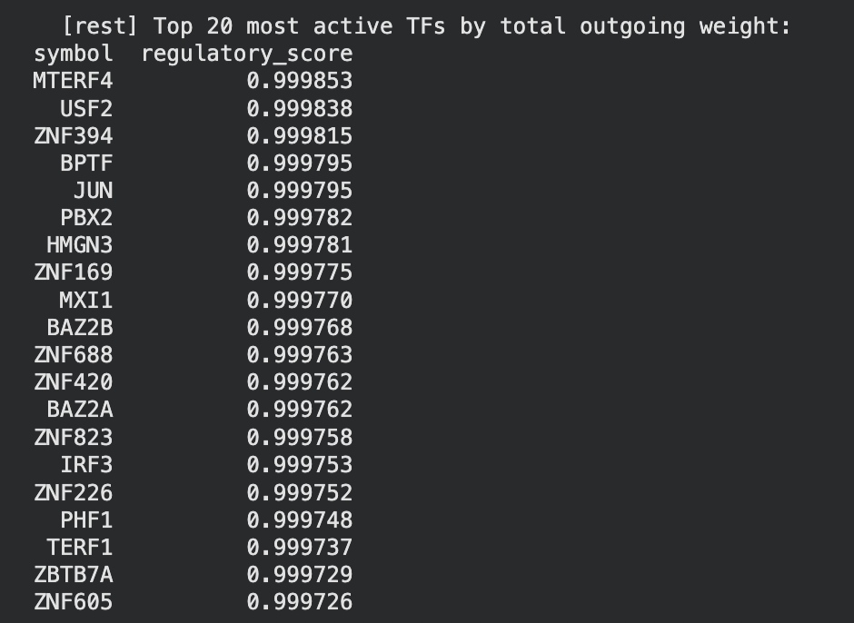
scPRINT GRN w most var across
Most “active” TFs for rest

Slide 20
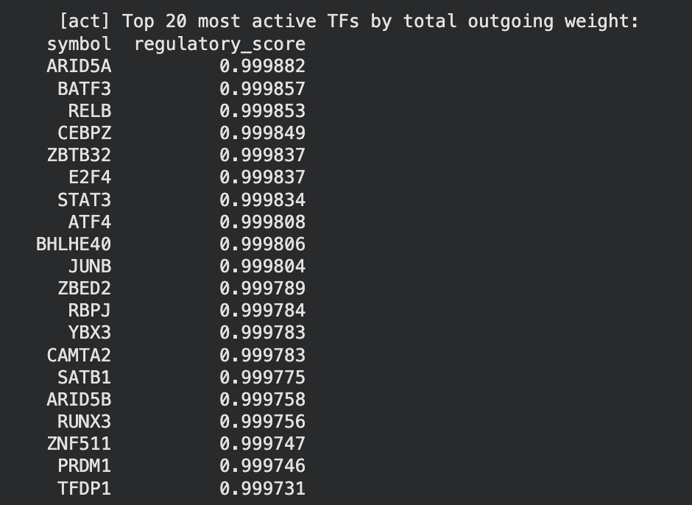
scPRINT GRN w most var across
Most “active” TFs for act

Slide 21
scPRINT GRN w most var within
Selects the 2000 genes that are most variable within each condition, without contrasting against other group
There is more overlap here within GRNs

Slide 22
scPRINT GRN w most var within
Cleaning rest GRN...
rest: 2000 genes, 153 identified as TFs, self-loops removed.
Cleaning act GRN...
act: 2000 genes, 144 identified as TFs, self-loops removed.

Slide 23
scPRINT GRN w most var within
Genes in rest network : 2000
Genes in act network : 2000
Genes shared in both : 928

Slide 24
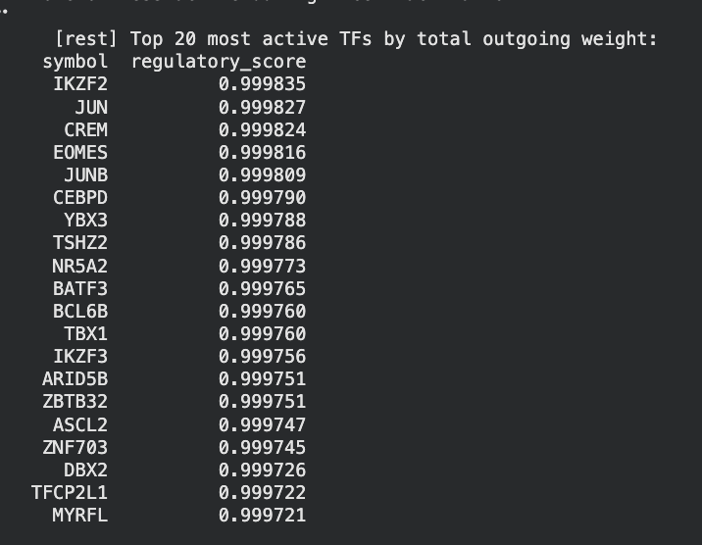
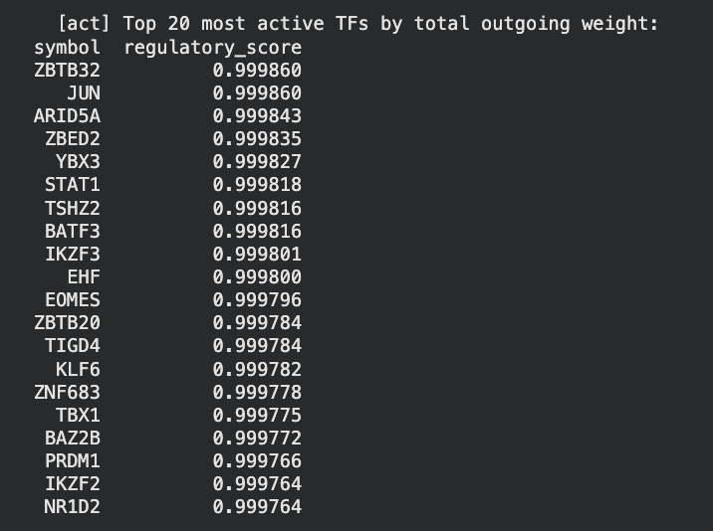
scPRINT GRN w most var across
Genes in rest network : 2000
Genes in act network : 2000
Genes shared in both : 928

Slide 25
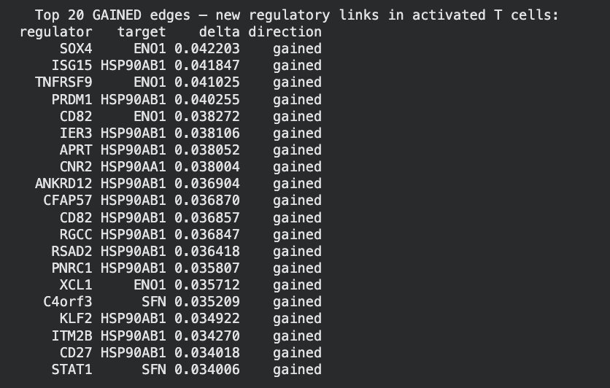
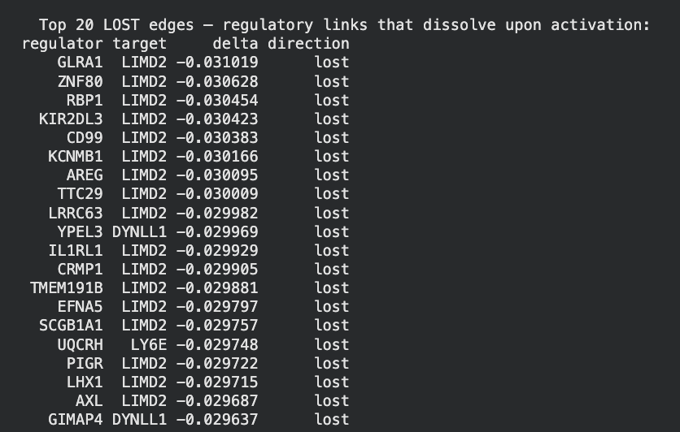
scPRINT GRN w most var across

Slide 26
TFs in Perturb-seq (from humanTFs_1639_clean.csv)
TFs in Perturb-seq : 990
TFs NOT in Perturb-seq : 649
% covered: 60.4%

Slide 27
TFs in Perturb-seq (from humanTFs_1639_clean.csv)
Both have NFAT family (NFAT5, NFATC1, NFATC2, NFATC3)
AP-1 Complex (FOS, FOSB..)
NF-kB family (NFKB1, ..)
IRF
STAT
RUNX
EGR

Slide 28
March 11
Create proper workflow for how the GRNs are created
Try GRN across both (and modify the cell argument to not distinguish between type, and then I Distinguish cell type)
Ask author
How do you analyze this matrix,
Organize things better
Check how many TFs are also in the rest_act
Human TFs + Perturb seq + cd4 (our data)
Human TFs + Perturb seq + cd8 (our data)
Use geneformer perturbation (things move to resting/acting) tells you direction, not which genes are getting perturbation (no log2fold change)
Extract the genes that chane in expression or the 990 only in the resting cell/active cells WHAT KIND OF CELL STATES ARE PRESENT IN WHAT PERTRUBATON
Basically you need ot get the perturb seq and verify its ground truth in respect to outline

Slide 29
Apr 6: Update
Goals 1 & 2 are making progress

Slide 30
Apr 6: Update (Goal 1)
Finding candidates TFs
pySCENIC-Net
Regulons extracted from regulons_mc9nr_withpruning.csv
Created pySCENIC-Net: 7,643 edges, 40 candidate TFs, 5,314 unique target genes
Candidate TFs (40) were drawn from top 20 deltaRSS [act - rest]
Perturb-seq cross check resulted in 23/40 candidates having quality knockdown data
Saved: candidate_tfs_pyscenic_targets.csv, candidate_tfs_perturbnet_targets.csv
Notes:
scenic.net
Columns
L
Source, target genes, delRSS (TF) [how active the tf is!!]
Two networks separately for rest and act

Slide 31
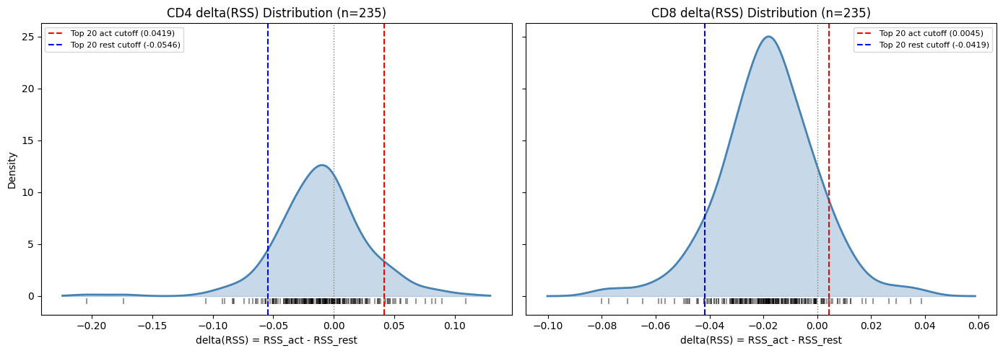
del(RSS) Plots [pySCENIC]
Notes:
Question - how to choose cut off, choose more cleanly as potential TFs for pyscenic

Slide 32
Apr 6: Update (Goal 1)
Finding candidates TFs
scPRINT
Contacted author on which “how” to use for GRN

Slide 33
Apr 6: Update (Goal 2)
Building Perturb-Net
Loaded perturb-seq dataset
Qualify filtering (only included ontarget_significant == True, offtarget_flag == False for no off-target contamination
Edge extraction with |logFC| > 0.5, adj_pval <0.05, self-edges removed [.5 is standard.. This is a tunable parameter]
Saved in datasets as perturb_net_tfs_only.csv, perturb_net_tf_summary.csv
Notes:
That's off-target contamination: your experiment thinks it's measuring "what happens when we knock down BATF3," but it's actually measuring "what happens when we knock down BATF3 AND accidentally also knock down some other gene we didn't mean to touch."

Slide 34
Apr 6: Next Steps
Goal 1: refine scPRINT and get their candidate TFs as well + get the edges and make scPRINT2-Net
Goal 2: filter down with scPRINT candidate as well for perturb-Net, verify against literature and perhaps retune the exact parameter for logFC thresholds
Goal 3: Edge overlap with pySCENIC + scPRINT2 + PeturbNet per TF?
Notes:
That's off-target contamination: your experiment thinks it's measuring "what happens when we knock down BATF3," but it's actually measuring "what happens when we knock down BATF3 AND accidentally also knock down some other gene we didn't mean to touch."

Slide 35
Creating perturbNet
Goals 1 & 2 are making progress

Slide 36
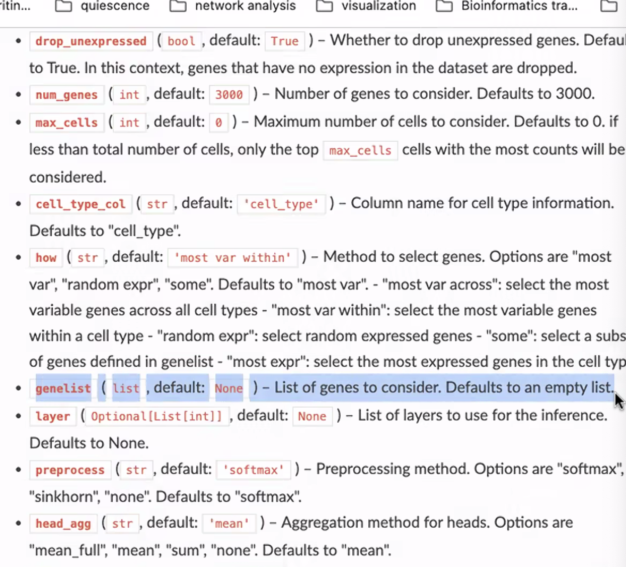
Apr 7
Create scenic Net with more columns (in updated file),
Check how RSS is calculated
Figure out which scPrint “how” to use and with geneList, look through all hyperparameyers
Separate rest/act in perturb-net (how many in rest/act) (8hr = active, resting)
In perturb-seq make perturb-net (refine for next meeting)
Notes:
scenic.net
Columns
L
Source, target genes, delRSS (TF) [how active the tf is!!]
Two networks separately for rest and act

Slide 37
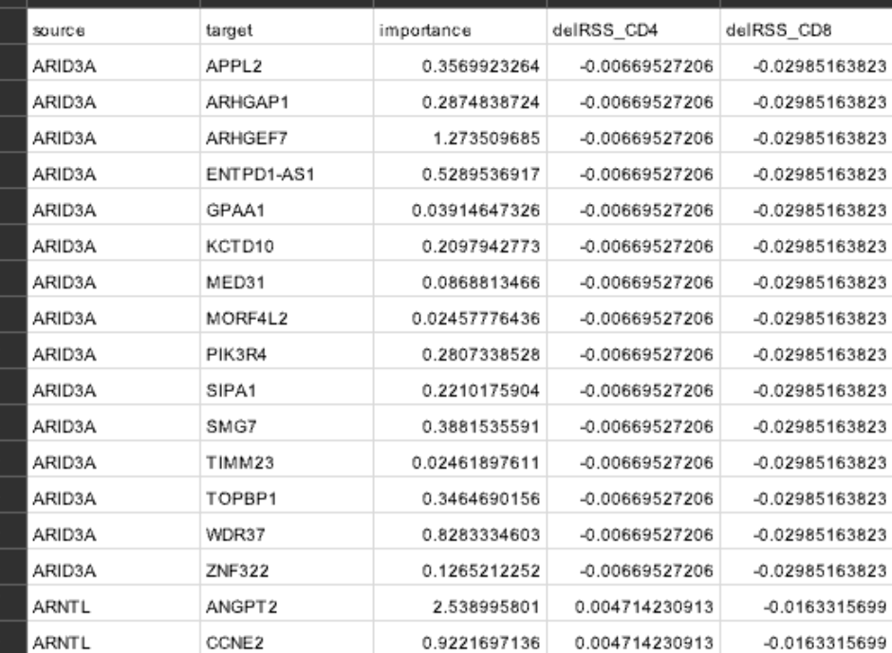
Apr 11: refining scenic_net
Created pyscenic_net_edges.csv,
Started with pySCENIC regulon output (reg) where each row is (TF, motif) pair. Columns get renamed.
TargetGenes is parsed and flattened into a long list of {tf, target, importance}
Remove duplicates and keep the max importance per pair
Remove self loops
Created scenic_net_full
Notes:
scenic.net
Columns
L
Source, target genes, delRSS (TF) [how active the tf is!!]
Two networks separately for rest and act

Slide 38
Apr 11: refining scenic_net
Created pyscenic_net_edges.csv,
Started with pySCENIC regulon output (reg) where each row is (TF, motif) pair. Columns get renamed.
TargetGenes is parsed and flattened into a long list of {tf, target, importance}
Remove duplicates and keep the max importance per pair
Remove self loops
Created scenic_net_full in this folder
Notes:
scenic.net
Columns
L
Source, target genes, delRSS (TF) [how active the tf is!!]
Two networks separately for rest and act

Slide 39
How is RSS created?
For every (cell type, regulon) pair, treat the regulon’s AUC vector and cell type’s membership as two probability distributions over cells and ask
“How similar are these two shapes”
Calculated with jensen-shannon DISTANCE
In our data:
Our inputs to RSS are:
AUC matrix + cell label types (CD4_rest, CD4_act, CD8_rest, CD8_act)
RSS asks, for every (cell group, regulon) pair, Are the cells where this regulon fires the same cells that belong to this group?
Notes:
scenic.net
Columns
L
Source, target genes, delRSS (TF) [how active the tf is!!]
Two networks separately for rest and act

Slide 40
Creating grn
Load data from tcell_embeddingd_filtered.h5ad
Build group 4 w cd4_rest, cd4_act, cd8_rest, cd8_act
Build genelist
Union of humanTFs and the HVGs in var_names
Symbol -> ensmbl conversion using bionty human gene table
Load scPRINT2 model from small-v2.ckpt
Align adata to model’s gene universe
Instantiate GNInfer with hyperparameters
Used a monkey patch here
Filter low quality cells
Run GRN inference in two loops
One for CD4 (CD4_rest, CD4_act), one for CD8 (CD8_rest, CD8_act)
Notes:
scenic.net
Columns
L
Source, target genes, delRSS (TF) [how active the tf is!!]
Two networks separately for rest and act

Slide 41
Creating grn: the hyperparameters
Used how = ‘some’
Why?
‘Most var across’ picks the 2000 genes that best discriminate one cell group from another
‘Most var within’ most 2000 variable genes inside each group
Both gene set changes between rest and act so the GRNs live in different genes, so we use
How = ‘some
A fixed shared gene axis
Guaranteed TF coverage
Notes:
scenic.net
Columns
L
Source, target genes, delRSS (TF) [how active the tf is!!]
Two networks separately for rest and act

Slide 42
Grn analysis
Notes:
scenic.net
Columns
L
Source, target genes, delRSS (TF) [how active the tf is!!]
Two networks separately for rest and act

Slide 43
Grn analysis
Load data from tcell_embeddingd_filtered.h5ad
Build group 4 w cd4_rest, cd4_act, cd8_rest, cd8_act
Build genelist
Union of humanTFs and the HVGs in var_names
Symbol -> ensmbl conversion using bionty human gene table
Load scPRINT2 model from small-v2.ckpt
Align adata to model’s gene universe
Instantiate GNInfer with hyperparameters
Used a monkey patch here
Filter low quality cells
Run GRN inference in two loops
One for CD4 (CD4_rest, CD4_act), one for CD8 (CD8_rest, CD8_act)
Notes:
scenic.net
Columns
L
Source, target genes, delRSS (TF) [how active the tf is!!]
Two networks separately for rest and act

Slide 44
Apr 14:
Put adj.matrix value for each pair (for scenic_net) (additional col)
Scanpy differential marker analysis (one group vs. rest)
Take those markers as some and the other parameter is geneList
Create scprint2_net
Notes:
scenic.net
Columns
L
Source, target genes, delRSS (TF) [how active the tf is!!]
Two networks separately for rest and act

Slide 45
Apr 21
Quick Checks
Get the proper scenic-net graphs
Check if sprint is symmetric
Check paper for perturb net, what dataset to use in perturb net and how does it correlate ours
Takie all resring cells and see which TFs thy prtuebr for resting cells
Perturbnet creation
Source tf, target will be changed upon pertubantion, log2fold change
Creation of Perturb Net (ONLY cd4)
Will be generating one network for resting and activating, not sure about activaitng (since perutbrnet has 3 dataset create 3 networks)
Select only the tfs that are perturbed ONLY in the resting dataset
Source, TF, Target, log2foldchange
Look into the genes that change upon perutbrantin (target genes),only assign as target gene if log2fold is significant
Significance value should be added too if given

Slide 46
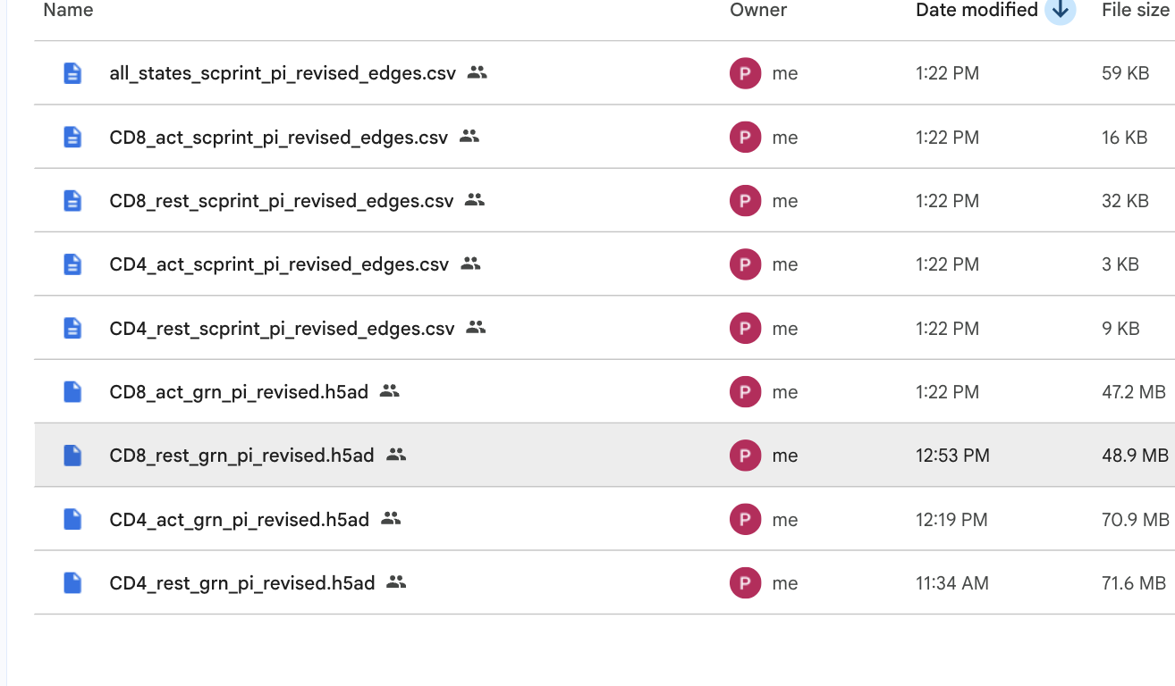
Apr 28 - recap
New scPRINT GRN analysis:

Slide 47
Apr 28
New scPRINT GRN analysis:

Slide 48
Apr 28 -
New scPRINT GRN analysis:

Slide 49
Apr 28
One more fix to scprint - i have to pick only significant pyscenic genelist ones
Where pval < 0.05. For the genelist in the wilcox method DE genes
Which edges are common in both states, intersection
Which edges in pyscenic_cd4rest are in scprint2_cd4rest.. etc
Repeat for all cell states
3. Adj_pval < 0.05 for perturb seq and update files
Read cole.et.al paper
Look at the kmeans formulation in this paper,
Look into GEARS and see how it works, and this is for experimentation
Put together result and method section
Make a huge table for how many TFs in scprint2, scenic, perturb net
Infographic for in common Tfs across all three files
COLUMNS are regulators (TFs), ROWS are targets

Slide 50
Apr 28
One more fix to scprint - i have to pick only significant scenic
IMPORTANT:

Slide 51
Apr 28
One more fix to scprint - i have to pick only significant pyscenic

Slide 52
Apr 28
One more fix to scprint - i have to pick only significant pyscenic

Slide 53
Task 3 (June 2) - KNN
Load embedddings
Read the dense response file
Build response matrix Y
Align embeddings to TFs
Cross validate the kNN
Run baselines on the same folds

Slide 54
Task 3 (June 2) - KNN [results]
=== Rest === (reading large file...)
560 TFs x 10282 genes (1 dropped, no embedding)
best kNN (k=25): 0.118 | Train Mean: 0.168 | Random@k: 0.112 | beats baseline: NO

Slide 55
Task 3 (June 2) - KNN [results]
=== Stim8hr === (reading large file...)
595 TFs x 10282 genes (1 dropped, no embedding)
best kNN (k=25): 0.137 | Train Mean: 0.189 | Random@k: 0.134 | beats baseline: NO

Slide 56
Task 3 (June 2) - KNN [results]
=== Stim48hr === (reading large file...)
575 TFs x 10282 genes (1 dropped, no embedding)
best kNN (k=25): 0.109 | Train Mean: 0.160 | Random@k: 0.105 | beats baseline: NO

Slide 57
Task 3 (June 2) - KNN [results]

